Slide 1

GENESIS ‘17

Slide 2
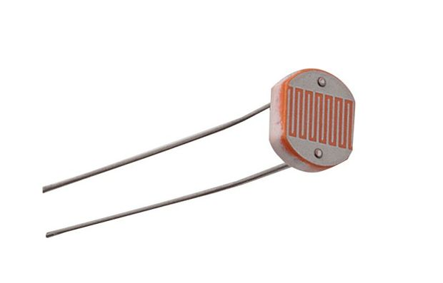
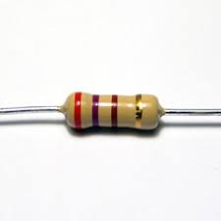
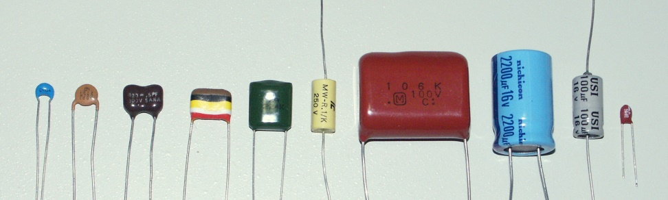
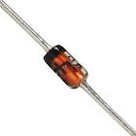
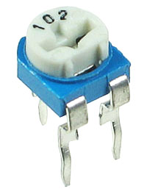
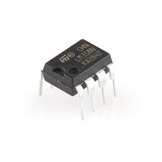
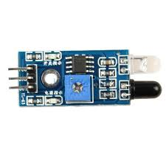
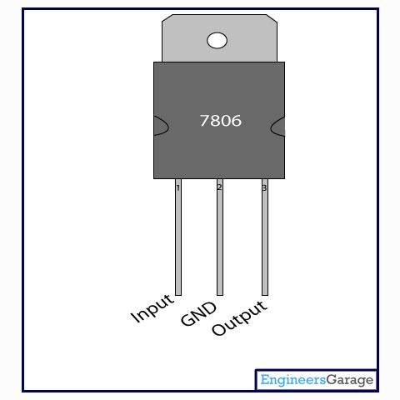
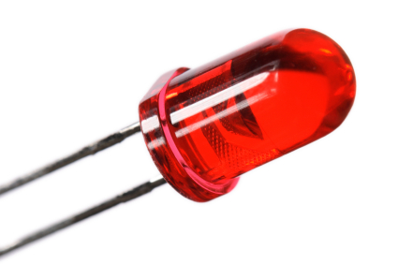
BASICS OF ELECTRONICS

Slide 3
RESISTORS
passive two-terminal electrical component
What is this resistor used for?
So how do we find the value of this resistance?

Slide 4
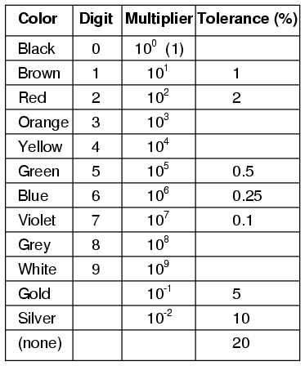
RESISTORS COLOR CODE FOR CARBON RESISTORS

Slide 5

LETS TRY THIS!!
Yellow-Violet-Orange-Gold
ANSWER:
47 kΩ with a tolerance of +/- 5%.

Slide 6
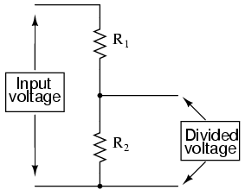
RESISTORS
Used to limit current in a circuit to protect components such as LEDs
Used as a voltage divider.

Slide 7
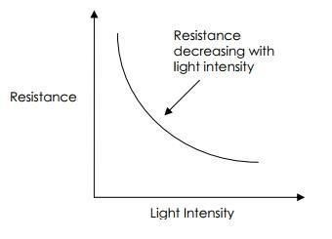
PHOTORESISTOR
Value of resistance changes with the light incident on it
So how does this happen?

Slide 8
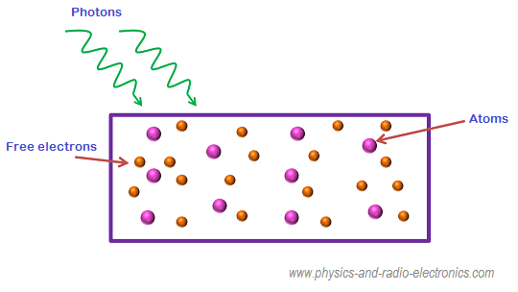
PHOTORESISTOR
made of semiconductor material
When light falls on photoresistor , some of the electrons jump from valence to conduction band and conduct current.
When light energy increases , more number of free electrons are generated and hence resistance is less.

Slide 9
CAPACITOR
A device used to store an electric charge, consisting of one or more pairs of conductors separated by an insulator.

Slide 10
POTENTIOMETER
Can be used as a voltage divider or as a variable resistor(rheostat)

Slide 11
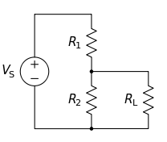
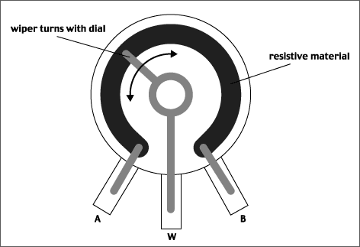
POTENTIOMETER
The resistance can be varied by placing the wiper anywhere between the terminals A and B.
It can be used as an ‘adjustable voltage divider’ by using all 3 terminals.

Slide 12
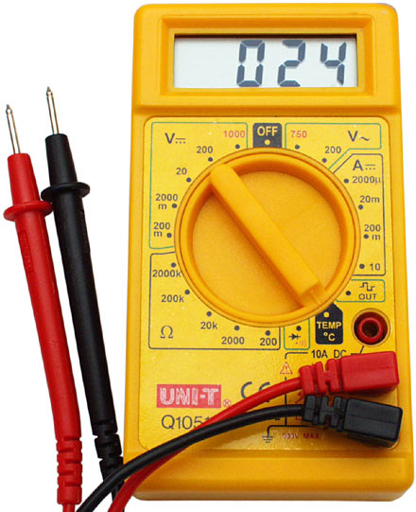
Multimeter basics
Current
Voltage
Resistance
Continuity

Slide 13
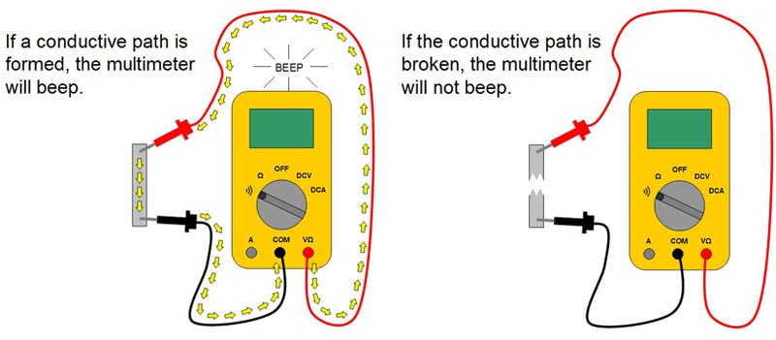
CHECKING CONTINUITY

Slide 14
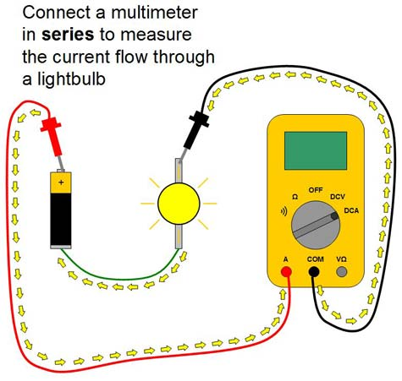
MEASURING CURRENT

Slide 15
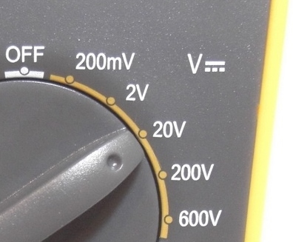
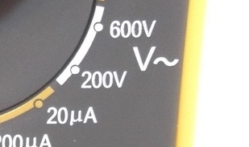
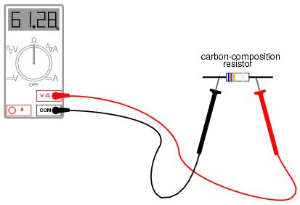
MEASURING POTENTIAL DIFFERENCE
DC
AC
PRECAUTION
DO NOT CONNECT PROBES DIRECTLY TO HOUSEHOLD AC MAINS!!!
MEASURING RESISTANCE

Slide 16
VOLTAGE REGULATORS(78XX SERIES)
Made of zener diodes and transistors
It basically gives a fixed output for a wide range of inputs.
Eg:
7805 gives a 5V as output as long as the input voltage is between 7V and 35V

Slide 17
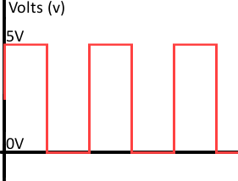
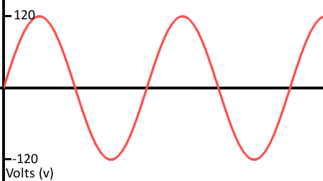
OPERATIONAL AMPLIFIER COMPARATOR(Op-Amps)
ANALOG SIGNAL
DIGITAL SIGNAL
It can have any value between the peak voltages at any instant of time.
It can have only finite number of values at different instants.
It takes only discrete values
Here it takes only 2 values 0(Low) and 5v(High).

Slide 18
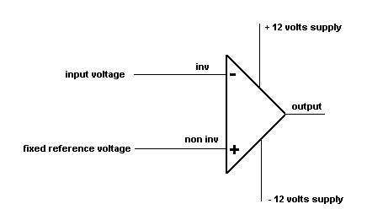
OPERATIONAL AMPLIFIER COMPARATOR(Op-Amps)
It compares the input voltage and fixed reference voltage and produces output accordingly.

Slide 19


OPERATIONAL AMPLIFIER COMPARATOR(Op-Amps)
If V+ > V then Vo=Vcc
(Digital High 1 output)
If V+ < V then Vo=0
(Digital Low 0 output)

Slide 20
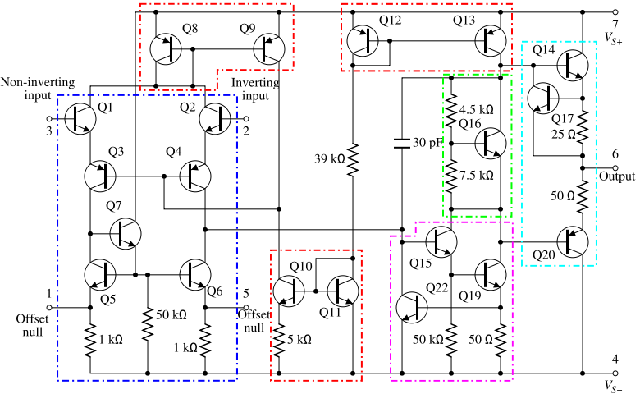
OPERATIONAL AMPLIFIER COMPARATOR(Op-Amps) INTERNAL CIRCUITRY

Slide 21
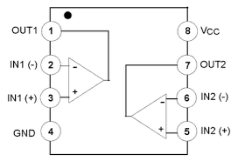
OPERATIONAL AMPLIFIER COMPARATOR(Op-Amps)
LM358- Dual Comparator

Slide 22

So till now we saw so many components. But how do I make a circuit out of them or connect them together and test circuits???

Slide 23
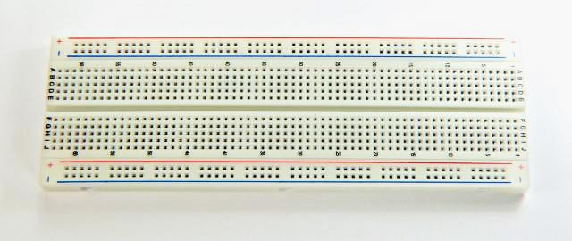
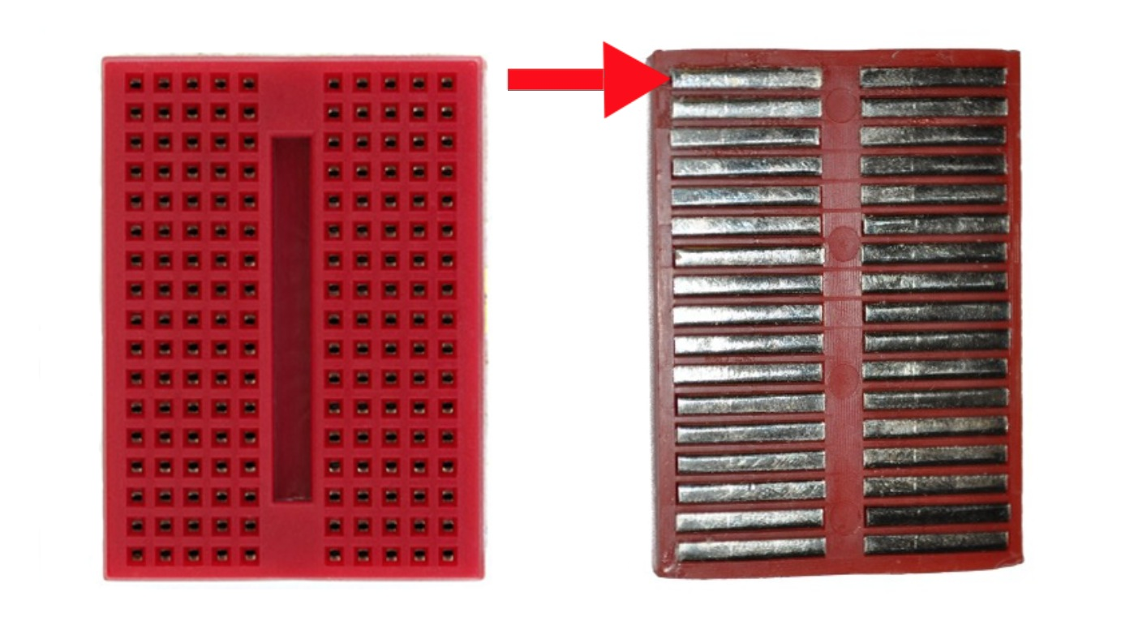
BREADBOARD

Slide 24
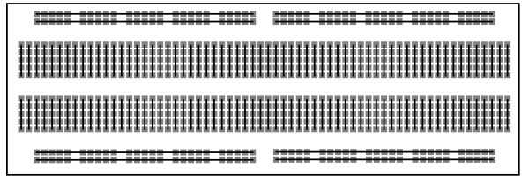
BREADBOARD-CONNECTIONS
The black line shows the columns and rows which are connected.
Now try connecting 2 resistors
in series and then in parallel

Slide 25


Series:
Parallel:
Notes:
MODULE

Slide 26
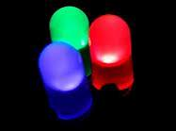
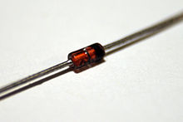
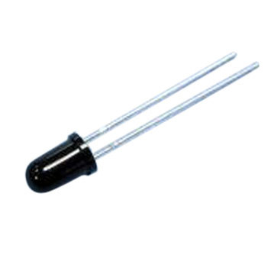

DIODES
LED
Zener diode
Photo diode
Conducts primarily in one direction
Similar to flow of water in a one way valve

Slide 27
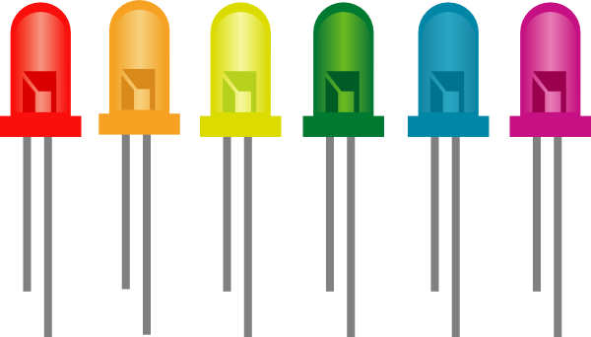

LIGHT EMITTING DIODE(LED)
The colour of the light emitted depends on the band gap energy of the diode.
Longer leg is anode, shorter leg is cathode

Slide 28
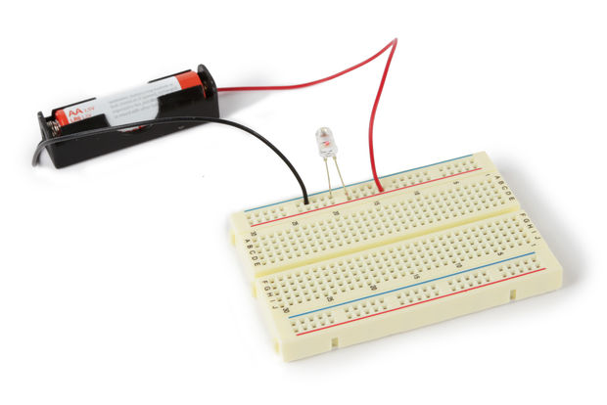
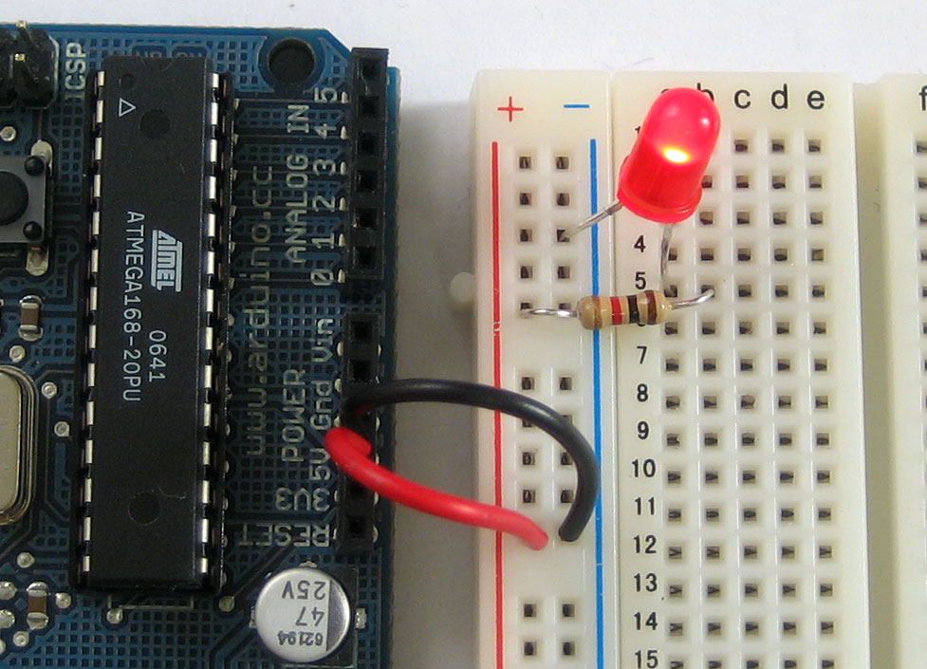

LIGHT EMITTING DIODE(LED)
WARNING!!!
Never connect an LED directly without a resistor

Slide 29
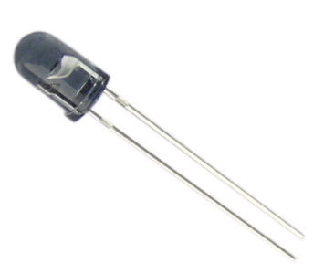
INFRARED LED
It emits in the infrared region and not in the visible range

Slide 30
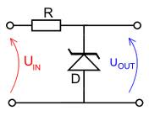
ZENER DIODE
It operates mainly in reverse bias.
It is used as a voltage regulator.

Slide 31

PHOTODIODE
Connected in reverse bias
Converts light into an electrical current.

Slide 32
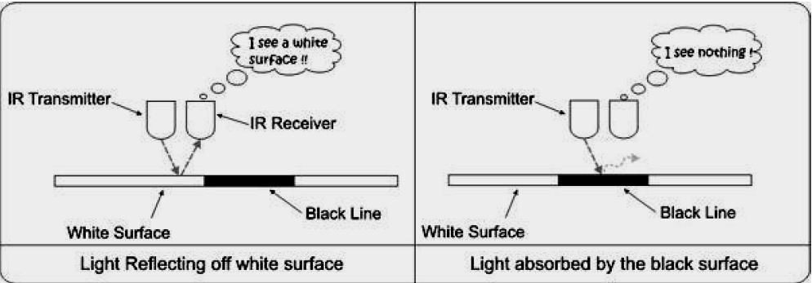
Let’s Try This Out!!
Make a black and white color sensor. Your circuit must respond (say Turn ON or OFF an LED) depending on the color that you show to your circuit. (You do not need any thing more than an Opto-coupler pair , an LED and a comparator to do this!!)

Slide 33
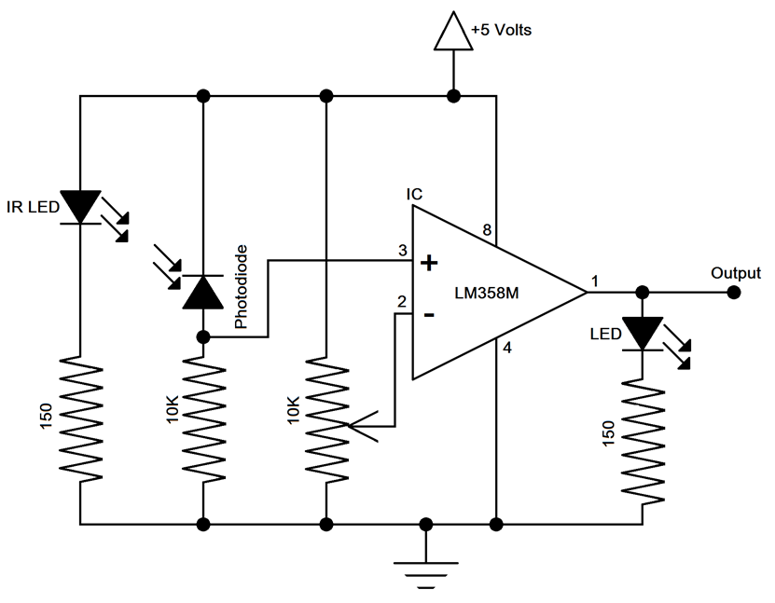
IR LED SENSOR

